Slide 1
Top 10 Azure AD features for developers
Chris Givens
Solliance.net
Office Server MVP, CISSP, CCNP
@givenscj

Slide 2
Agenda
Azure AD Introduction
Azure Top Ten Developer Features

Slide 3
What is Azure AD?

Slide 4
Azure Active Directory Introduction
Microsoft’s multi-tenant, cloud based identity management service
Free, Basic and Premium editions
User, Group and App Management
Utilizes standard protocols to enable SSO scenarios
Both Microsoft and 3rd party application supported
Sync of local Active Directory via Connect tool

Slide 5
Azure AD Developer Top 10

Slide 6
Azure AD Top Features #10 Extended Properties
Supported Object Types
Users, Groups, Tenant Details, Devices, Applications, Service Principals
Property Types
Binary - 256 bytes maximum
Boolean
DateTime - Must be specified in ISO 8601 format. Will be stored in UTC
Integer - 32-bit value
LargeInteger - 64-bit value
String - 256 characters maximum
Assigned\Created based on Azure AD Application

Slide 7
Extended Properties Demo

Slide 8
Azure AD Top Features #9 Modern Authentication Protocols
OAuth 2.0
Client credentials; On-Behalf-Of; Implicit Flow
OpenID Connect
WS-Federation
SAML 2.0
Single Sign On/Out
Automatic Key Rollover
Most apps already support this
Supports both JWT and SAML
Notes:
https://docs.microsoft.com/en-us/azure/active-directory/develop/active-directory-signing-key-rollover
https://docs.microsoft.com/en-us/azure/active-directory/develop/active-directory-token-and-claims

Slide 9
Modern Auth Protocols Demo

Slide 10
Azure AD Top Features #8 App Registration and Consent
Azure AD Apps can be single or multi tenant
ClientID and Secret are generated
Consent must be given when multi-tenant
Azure provides consent permission sets
Custom consents can be created
User level vs Administrator level
Any user can consent to user level permission requests (unless app is blocked)
Only admin can conset to admin level permissions
Five primary scenarios
Web Browser->Web Application
Single Page App (SPA)
Native App to Web API
Web Application->Web API
Daemon\Server App to Web API
Notes:
https://docs.microsoft.com/en-us/azure/active-directory/develop/active-directory-authentication-scenarios
https://github.com/cljung/azwebaadtiny/blob/master/Provision-AADApplicationInTenant.ps1

Slide 11
Azure AD Top Features #8 (Cont) App Registration and Consent
Consent prompts
First time an application is used
After a user revokes required permissions
A new feature is “lit-up” and needs more permission
Incremental/dynamic consent
Manageability?
Admin views of apps and consents
Controls over what apps and permissions can be assigned

Slide 12
Azure AD Top Features #8 (Cont) App Registration and Consent
Do you know what apps have access to your cloud data?
User Revocation – It’s important
Facebook
Twitter
Google
LiveID
Azure AD

Slide 13
App Registration and Consent Demo

Slide 14
Azure AD Top Features #7 Azure B2B and B2C capabilities
Azure supported both B2B and B2C
B2B = Corporate
B2C = Other Social Identities
B2B and B2C are not the same directory
B2C must be created separately in your tenant
Notes:
https://docs.microsoft.com/en-us/azure/active-directory/active-directory-b2b-compare-b2c

Slide 15
Azure AD Top Features #7 Azure B2B capabilities
B2B
Ability to trust other organizations that also reside in Azure AD or which trust has been setup
Be careful trusting other organizations, the federation on the back side could be compromised
Partner lifecycle, security, compliance and branding managed by the host/inviting organization
SSO to all Azure-AD connected apps is supported
Notes:
https://docs.microsoft.com/en-us/azure/active-directory/active-directory-b2b-compare-b2c

Slide 16
Azure AD Top Features #7 Azure B2C capabilities
B2C (think Auth0)
Different Azure Active Directory “instance”
Authenticate with customer’s preferred identity provider
Requires you to create an application in each IdP
Supports several Identity Providers
Microsoft Account, Facebook, Twitter, Google, LinkedIn, Amazon, Weibo, QQ, WeChat, GitHub
Custom Policies for sign-up, sign-in, edit profile and reset password
Each policy can have a different branding
Custom policies can be targeted at
Users
Identity Provider
Notes:
https://docs.microsoft.com/en-us/azure/active-directory/active-directory-b2b-compare-b2c

Slide 17










Azure Active Directory B2C
Azure AD B2C
Customers
Business
Social IDs
Apps
Securely authenticate customers with their preferred identity provider
Provide branded registration
and login experiences
Analytics
Business & Government IDs
Capture login, preference, and conversion data for customers
CRM and Marketing Automation
contoso

Slide 18
B2C Demo

Slide 19
Azure AD Top Features #6 Microsoft Graph \ Azure Graph API
REST API Endpoints for Azure AD object access
Allows CRUD operations on data and objects
Authenticated with Azure AD
Authentication Header vis JWT
User or admin consent must be given to gain access to a token
Role-Based Authorization (RBAC)
Differential Query
Allows to find changes in Azure AD between two time periods

Slide 20
Azure AD Top Features #6 (Cont) Microsoft Graph \ Azure Graph API
Graph Reference
https://developer.microsoft.com/en-us/graph/docs/concepts/overview
Graph Explorer
https://developer.microsoft.com/en-us/graph/graph-explorer

Slide 21
Azure Graph API Demo

Slide 22
Azure AD Top Features #5 Integration with ADFS/3rd Party Auth
Active Directory Federated Services (ADFS)
AD Pass-Through Auth
Request for login go directly to the internal Active Directory
3rd Party
Auth0, Ping, Okta
Identity Server, Policy Server
Multi Factor Auth (MFA)
Support for Duo, RSA and Trusona
It’s all about TRUST!
Do you trust other people’s trust of other people’s trust of other people’s trust?

Slide 23
Identity Integration Demo

Slide 24
Azure AD Top Features #4 Azure Active Directory Domain Services
Run Active Directory in Azure Virtual network
What scenarios does this enable?
‘Lift-and-shift’ LDAP applications
‘Lift-and-shift’ Kerberos applications
‘Lift-and-shift’ SharePoint server
Manage Azure IaaS virtual machines
Domain-joined HDInsight clusters
Remote desktop deployments
Notes:
Azure Marketplace is a powerful channel to market and sell your cloud solutions certified to run on Azure. Showcase virtual machine images and solution templates and get access to our top Azure customers worldwide.

Slide 25
Azure AD Top Features #3 Token Lifetime Policies
Token Types
Access Tokens – 1 Hour
Based on User, client, resource
Careful to balance performance and time between password reset/user revoke!
Refresh Tokens (Confidential, Public) – 90 Days
Used to get an updated access token
Session Tokens (Persistent, NonPresistent) – Until-Revoked
Assigned to browser after user signs in
ID Tokens – Until-Revoked
Contain user profile information

Slide 26
Azure AD Top Features #3 (Cont) Token Lifetime Policies
Policies can target specific principals
Organization app
Multi-tenant app
Service principal
Aka “Yammer”
More than one policy can be applied
Policy with the highest priority is applied
Explicitly assigned; Parent Org of Service Principal; Policy of Application; Default Values
Balance must be established
Employees that leave can still access resources with longer expiration times (default 1 hour)
Notes:
https://support.office.com/en-ie/article/improve-office-365-sign-in-for-yammer-with-auto-acceleration-policy-4d0e5067-992c-4cd6-bad5-b4ac0d52f596

Slide 27
Azure AD Top Features #3 (Cont) Token Lifetime Policies Example
Get-Module AzureADPreview
Install-Module AzureADPreview
2.0 Preview
New-AzureAdPolicy

Slide 28
Token Lifetime Policy Demo

Slide 29
Azure AD Top Features #2 Conditional Access Policies
Evaluation of conditions before allowing successful Sign-In
Sign-in Risk – high probably of a bad actor
Network location – Impossible travel; outside of internal network; non-approved locations
Device Management – Allow only domain registered devices; Block device types; enforce device compliance
Client Application – type of app; known bad apps
Supported on SharePoint and Exchange

Slide 30
Conditional Access Demo

Slide 31
Azure AD Top Features #1 Security! Security! Security!
Real-time adaptive machine learning for anomaly detection (Advanced Threat Detection)
Six different risk types detected
Microsoft Intelligent Security Graph
Recommendations to improve security posture
Logging for reporting, investigations and run book execution
Dashboard and email reporting on many different risk types
Smart Account Lockout
Lockout Threshold – default 10 failed attempts
Lockout Duration – default 60 seconds
Automatically increases with a continuing attack
Access Reviews
Ensure that permission creep doesn’t continue
Privileged Identity Management
Enforce on-demand, just-in-time access

Slide 32
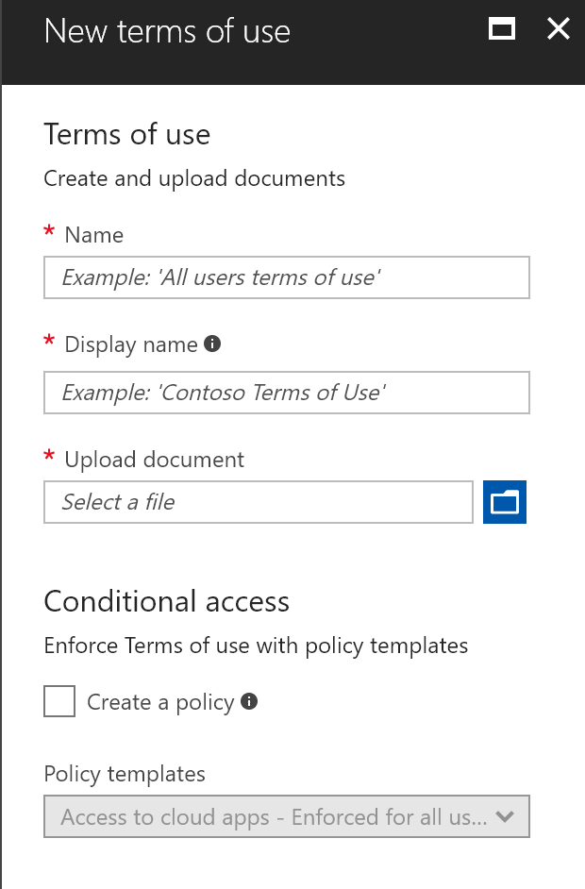
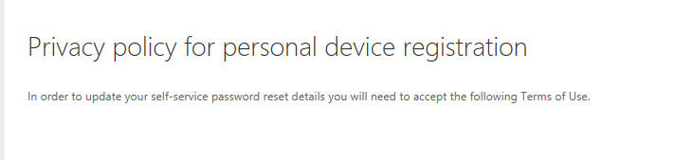
Azure AD feature - Terms of use
NEW
Configure, enforce, audit compliance
​Configure a terms of use by uploading a PDF document
Target to users, groups or applications using conditional access​
Enforce acceptance of terms for users in scope
Optionally configure multiple policies, for different business needs
Audit events show who accepted / which terms / when
Create a Terms of Use
Enforce at Sign-In
Users consent
Review audit reports

Slide 33
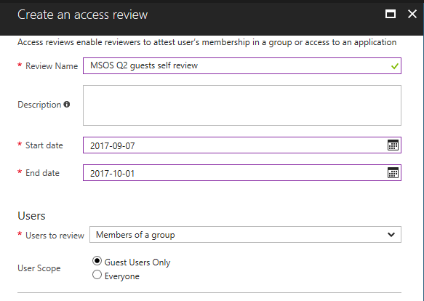
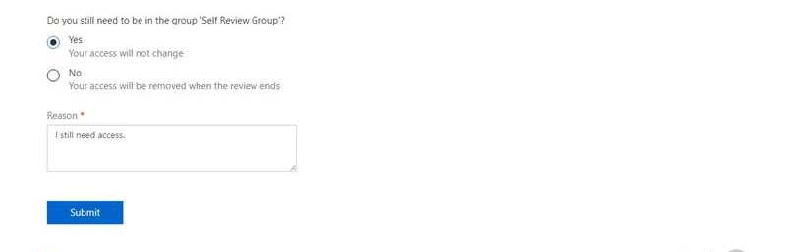
Azure AD feature - Access reviews
NEW
Recertify: attest and audit continued access
​Review Office group members, security group members, and users assigned to applications
Optionally, scope the reviews to just guests
Select reviewers from the resource
Group owners
Members review their own access
Select other specific individuals
Create an access review
Reviewers give feedback
Results applied
Review audit reports

Slide 34
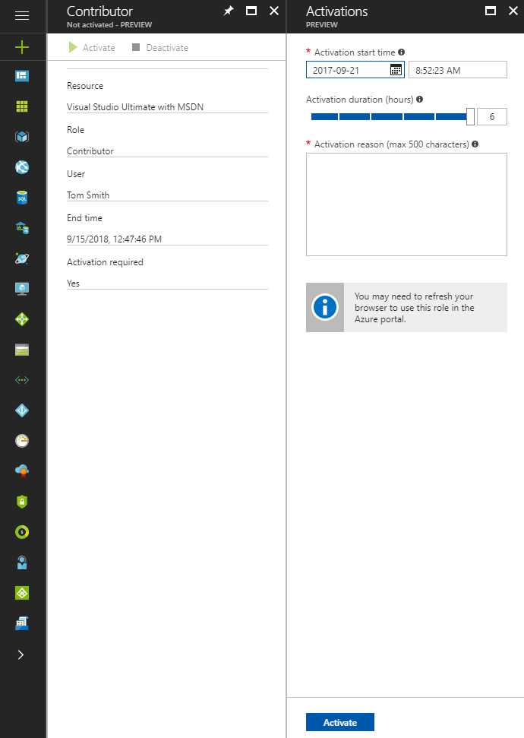
Azure AD feature - PIM for Azure
NEW
Discover, restrict, and monitor roles in Azure
Enforce on-demand, just-in-time access in Azure RBAC
Schedule time-limited access with automatic expiration
Attest subscription role memberships with access reviews
Converged audit view of Azure management activity
Ordinary user
Resource group Contributor
Role privileges expire after a specified interval
Ordinary user

Slide 35
Security Demo

Slide 36
Summary

Slide 37
Azure Active Directory Summary
It’s got everything but the kitchen sink!

Slide 38
Azure AD Questions\Comments?
What’s on your mind?
Need help securing and learning?

Slide 39
Azure AD Contact
Chris Givens
chris@solliance.net
@givenscj

Slide 41
Bonus Features

Slide 42
Azure AD Top Features #11 Branded Experience (B2B and B2C)
B2B
Ensure users that they are connecting to the right tenant
Banner logo
Username hint
Sign-in page text
Sign-in page image
Background color
User tenant vs destination login experience
B2C
Customized UI hosted anywhere with CORS support
No JavaScript
All
Language targeted content
Notes:
https://docs.microsoft.com/en-us/azure/active-directory/customize-branding
https://cloudblogs.microsoft.com/enterprisemobility/2017/04/07/improving-the-branding-logic-of-azure-ad-login-pages/
There can be up to four relevant and different brands for any sign-in flow:
The brand of the app that the user is signing into, or providing consent for (e.g. Office)
The brand of the organization that owns the resource (e.g. the app belongs to Fabrikam)
The brand of the organization that the user is a member of (e.g. user is a Contoso employee)
The brand of the platform/service provider (e.g. Microsoft).

Slide 43
B2B and B2C Branding Demo

Slide 44
Azure AD Top Features #12 App Gallery
Have a cool app? Publish it for others to see and use!
Grow your cloud business with Azure Marketplace
Reach more enterprise and SMB customers for your cloud solutions
Drive more leads, grow revenue
https://azuremarketplace.microsoft.com/en-us/marketplace/apps
Notes:
Azure Marketplace is a powerful channel to market and sell your cloud solutions certified to run on Azure. Showcase virtual machine images and solution templates and get access to our top Azure customers worldwide.

Slide 45
App Gallery Demo

